Slide 1
Omega Psi Phi Fraternity, Inc. Upsilon Nu Chapter Recommendations Committee Executive Summary 2022
Recommendations SOP
Complete Recommendations Submittal Form
(RecommendationsSubmittalFormUpsilon.docx)
All recommendations and request to the Chapter shall go through this process
Forms received by the tenth business day of the month will be reviewed by the committee and submitted to the Executive Committee for review in that month
Recommendations can also be made without a form by communicating with the committee that the recommendation impacts (e.g., if you are requesting a contribution for an event or cause, this could go through the Social Action Committee)
All Recommendations submittal need to be received one month prior to the recommended decision date.

Slide 2
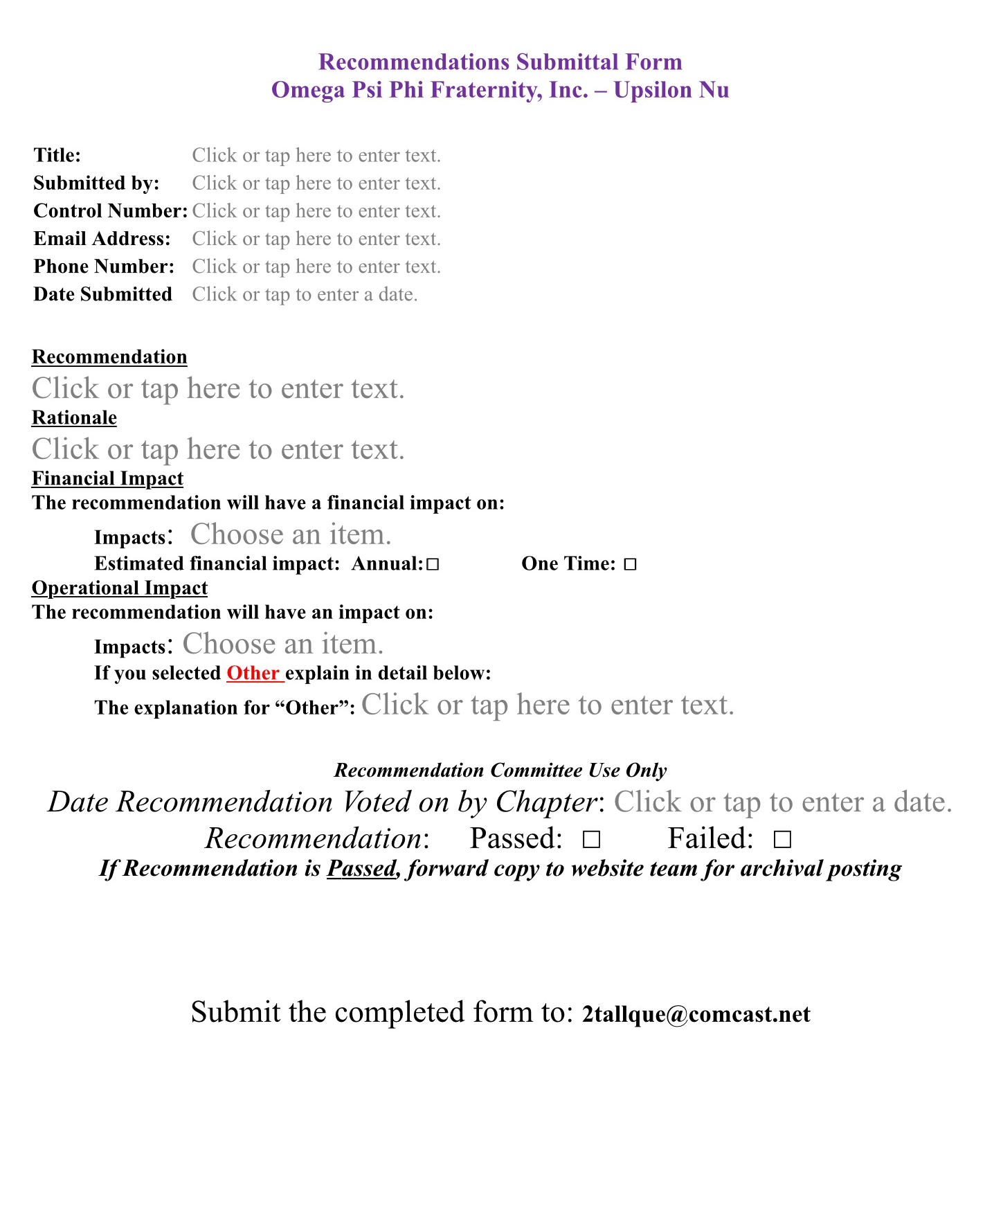
Recommendations Submittal form Standard Operations Procedure
Recommendations Submittal Form Upsilon Nu 2021.docx
SIX WORD TITLE OF RECOMMENDATION
YOUR NAME, CONTROL#, E-MAIL ADDRESS AND PHONE NUMBER
DATE SUBMITTED VIA E-MAIL
TWENTY-FIVE WORD DESCRIPTION OF RECOMMENDATION
RATIONALE FOR RECOMMENDATION TO INCLUDE WHY THIS RECOMMENDATION IS BEING MADE AND THE DESIRES OUTCOME
FINANCIAL IMPACT TO INCLUDE IF IT IS A REQUEST FOR FUNDS AND / OR AN ASSESMENT ON CHAPTER BROTHERS OR CANDIDATES FOR MEMBERSHIP
IMPACT OF THIS RECOMMENDATION (CONSTITUTION / BY – LAWS / DUES / OTHER
FORMS MUST BE SUBMITTED TO COMMITTEE 30 DAYS PRIOR TO CHAPTER MEETING DATE TO ENSURE REVIEW AND ACTION BY THE EXECUTIVE COMMITTEE

